Slide 1


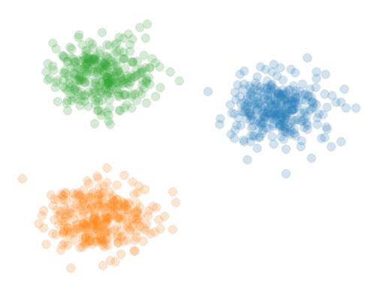
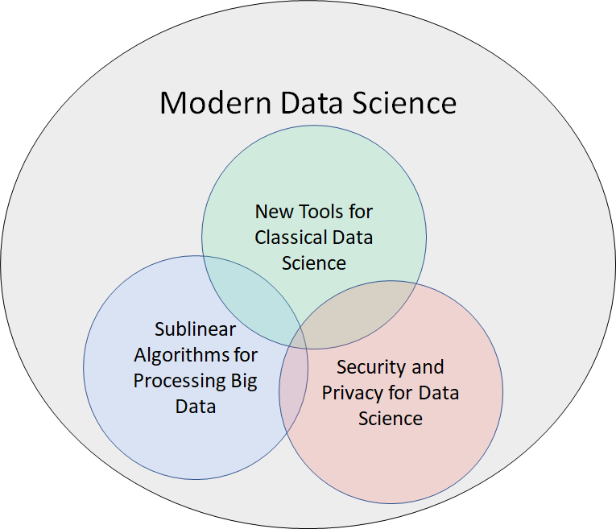

Theoretical Foundations of Modern Data Science
Samson Zhou
Notes:
Talk slower, balanced syllables

Slide 2



Background
Post-doc at UC Berkeley / Rice
Previous: Post-doc at Carnegie Mellon
PhD in Computer Science from Purdue
Dual Bachelors in Math, Computer Science from MIT
Research areas: Data science, sublinear algorithms, security and privacy
Notes:
I’m currently a postdoc at UC Berkeley and Rice. My research areas fall under the foundations of data science, sublinear algorithms, and security and privacy, but the central theme is introducing provable guarantees and efficient implementations for big data algorithms subject to evolving modern demands. Specifically, my goal is to have substantial real-world impact through research, teaching, and service, and so I’m looking for a platform that will enable and empower me to have such impact, which is why I’m so excited for the opportunity to apply to academia and industry research positions.

Slide 3

Data Science
Notes:
Enough about me, let’s talk about data science. Sources of big data are now universally present, across social media, financial markets, Internet of things, scientific data, so on and so forth, and thus understanding how to effectively and efficiently summarize the data is a crucial step toward both understanding past events as well as predicting future events.

Slide 5





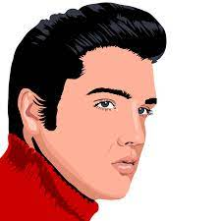


Slide 6
1 1 0 1 0 1
0

Slide 7
1 1 0 1 0 1
0 1 1 1 0 0
0
1
Notes:
Example: regression

Slide 8
1 1 0 1 0 1
0 1 1 1 0 0
0 1 0 1 1 1
0 1 1 0 1 0
1 0 1 1 1 1
0 1 1 1 0 1
0 0 1 0 1 1
0
1
1
0
0
1
0
Notes:
Example: regression

Slide 9
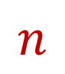
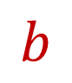
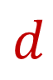

$$A$$
$$b$$
1 1 0 1 0 1
0 1 1 1 0 0
0 1 0 1 1 1
0 1 1 0 1 0
1 0 1 1 1 1
0 1 1 1 0 1
0 0 1 0 1 1
0
1
1
0
0
1
0
$$n$$
$$d$$
Notes:
Example: regression

Slide 10
$$A$$
$$b$$
1 1 0 1 0 1
0 1 1 1 0 0
0 1 0 1 1 1
0 1 1 0 1 0
1 0 1 1 1 1
0 1 1 1 0 1
0 0 1 0 1 1
0
1
1
0
0
1
0
$$n$$
$$d$$
Notes:
Example: regression

Slide 11
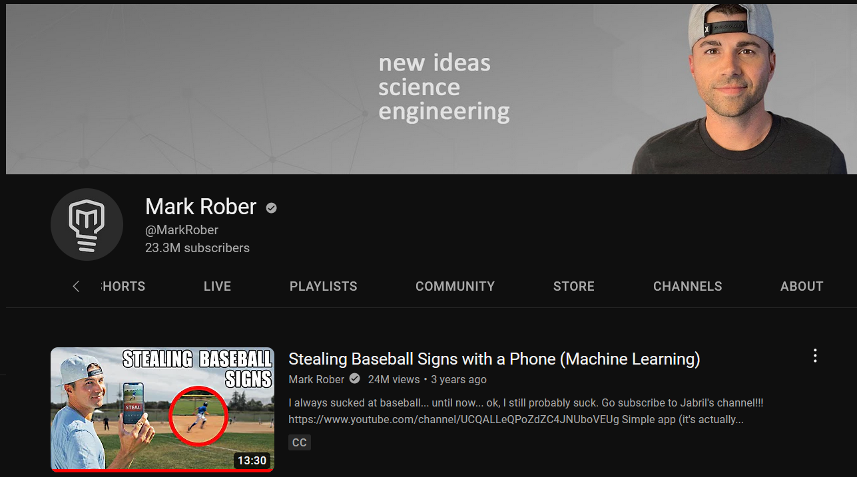

Slide 12

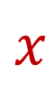
$$A$$
$$b$$
1 1 0 1 0 1
0 1 1 1 0 0
0 1 0 1 1 1
0 1 1 0 1 0
1 0 1 1 1 1
0 1 1 1 0 1
0 0 1 0 1 1
0
1
1
0
0
1
0
$$x$$
$$n$$
$$≈$$
$$d$$
Notes:
Example: regression

Slide 13
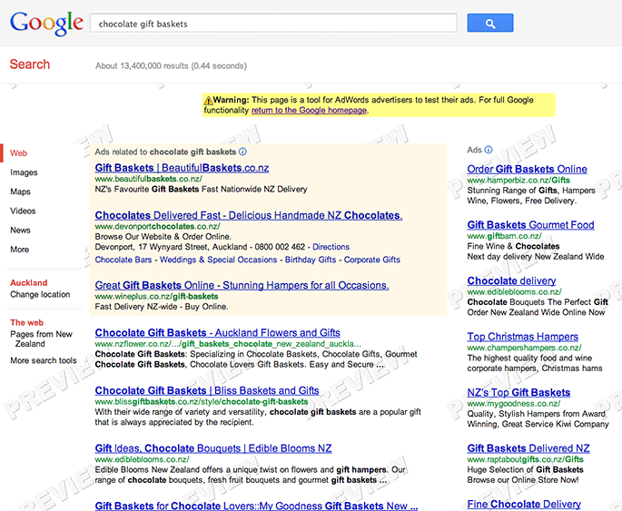

Slide 14
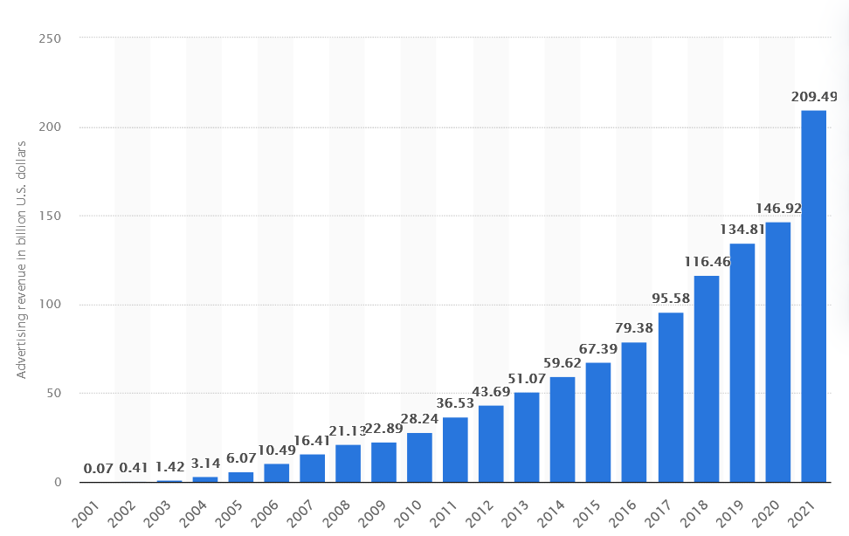

Google Ad Revenue (2001-2021, billion USD)

Slide 15
Modern Data Science
New Tools for Classical Data Science
Sublinear Algorithms for Processing Big Data
Security and Privacy for Data Science

Slide 16
Evolving Demands
Sublinear-time or sublinear-space algorithms
Incorporation of advice
Security and privacy
Robustness to noise or adversarial input
Ability to handle time-sensitive data
Notes:
However, as the field of big data algorithms matures, we have realized that often implementing an algorithm to simply perform analysis is not enough; we might also require specific properties or functionality from the algorithm, such as sublinear-time or sublinear-space, incorporation of advice, security and privacy, robustness to noise or adversarial input, or the ability to handle time-sensitive data. These are crucial qualities that I’ve integrated into my research on algorithmic design and so throughout this talk as I summarize some of my broader work in each of the Venn diagram categories, I’ll also interleave discussion of these modern demands.

Slide 17
New Tools for Classical Data Science
Notes:
Green circle

Slide 18
Evolving Demands
Sublinear-time or sublinear-space algorithms
Incorporation of advice
Security and privacy
Robustness to noise or adversarial input
Ability to handle time-sensitive data

Slide 19
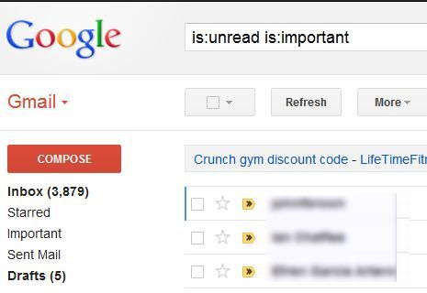

330 billion daily e-mails
3 billion monthly active users
8.5 billion daily Google searches

Slide 20

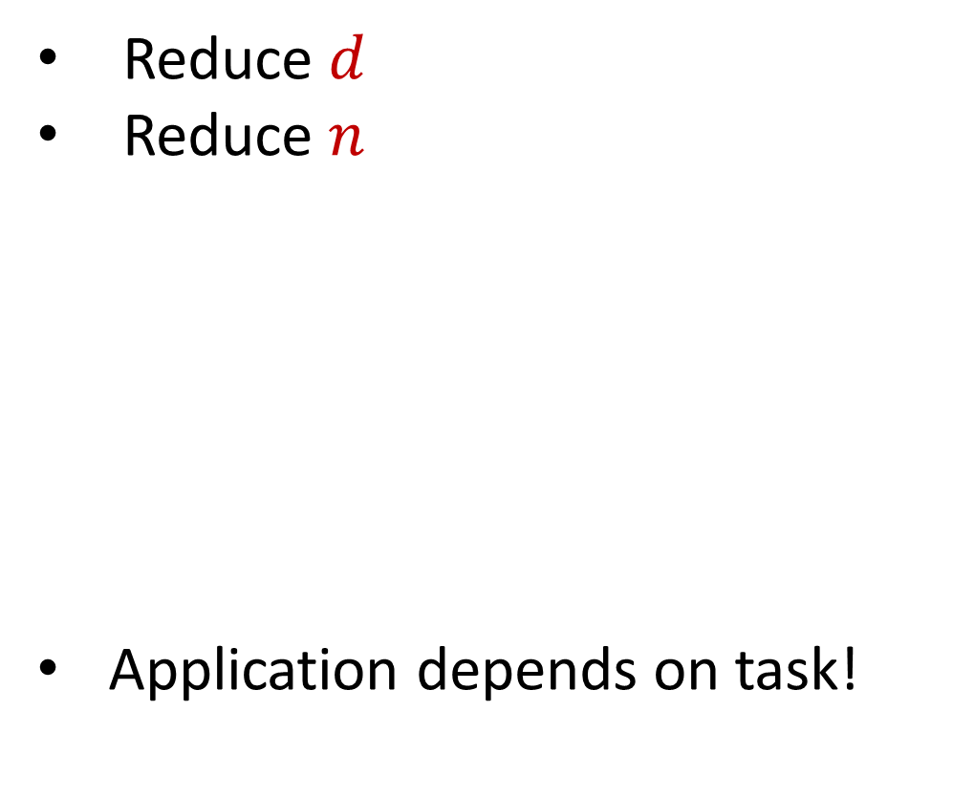

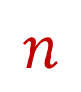
Dimensionality Reduction
Reduce $d$
Reduce $n$
Application depends on task!
Sampling, Sketching, Johnson-Lindenstrauss, IsoMap
$$n$$
$$A$$
Sampling, Sketching,
Coresets
$$d$$
Notes:
n = observations, d = features

Slide 21
New Dimensionality Reduction Results
Dimensionality reduction for Wasserstein barycenter [ISZ21]
Sketching for valuation functions, e.g., additive, submodular, Lipschitz [YZ19]
Kernel density estimation on kernel matrices [BKISZ22]
Notes:
Too fast

Slide 22
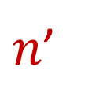

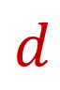
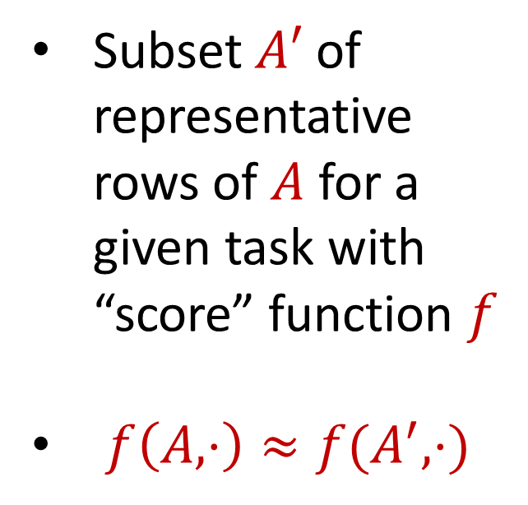
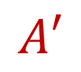
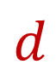
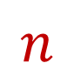
Coreset
Subset $A′$ of representative rows of $A$ for a given task with “score” function $f$
$f\left(A,⋅\right)≈f(A^{′},⋅)$
$$n$$
$$A$$
$n$’
$$A′$$
$$d$$
$$d$$

Slide 23
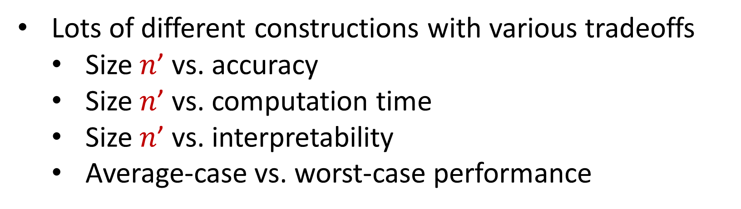
Coreset
Lots of different constructions with various tradeoffs
Size $n$’ vs. accuracy
Size $n$’ vs. computation time
Size $n$’ vs. interpretability
Average-case vs. worst-case performance

Slide 24
New Coreset Constructions
Coresets for data-independent neural pruning [MOBZF20]
Coresets for projective clustering [TWZBF22]
Coresets for regression on structured matrices [MMMWZF22]
Online coresets for linear algebra [BDMMUWZ20]
General coreset construction framework through sensitivity sampling [BFLSZ21]

Slide 25
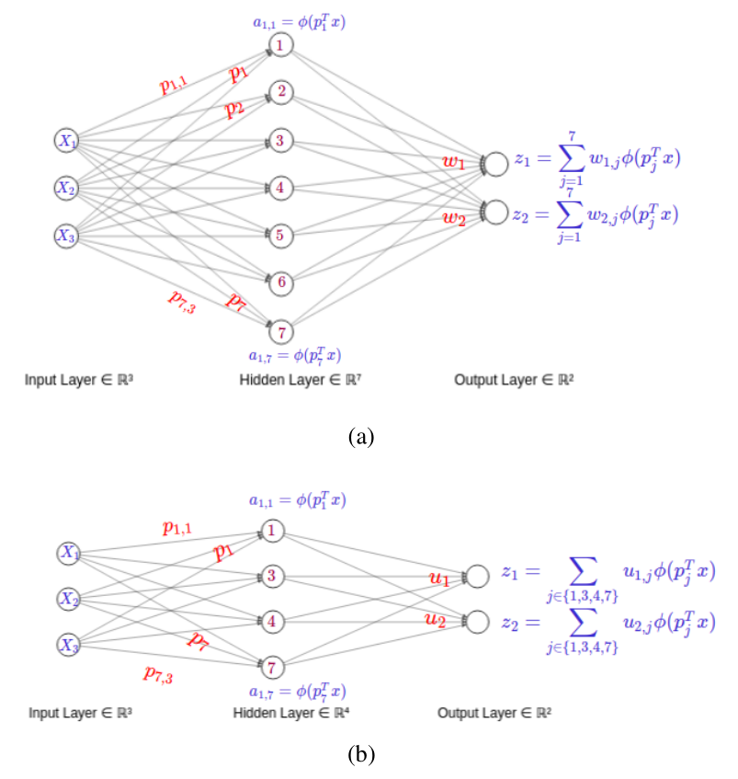
[MOBZF20]

Slide 26
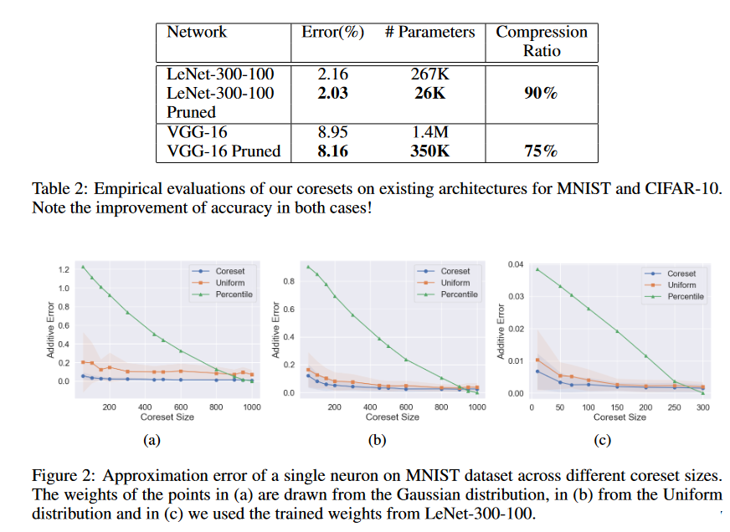
[MOBZF20]
Notes:
LeNet-300-100 is a multi-layer perceptron with two fully connected hidden layers with 300 and 100 neurons correspondingly, trained on MNIST data set. VGG-16 includes 5 blocks comprising convolutional and pooling layers, followed by 3 dense layers – the first two with 4096 neurons and the last with 1000 neurons. The model was trained and tested on CIFAR-10
Lottery ticket hypothesis

Slide 27
Evolving Demands
Sublinear-time or sublinear-space algorithms
Incorporation of advice
Security and privacy
Robustness to noise or adversarial input
Ability to handle time-sensitive data

Slide 28
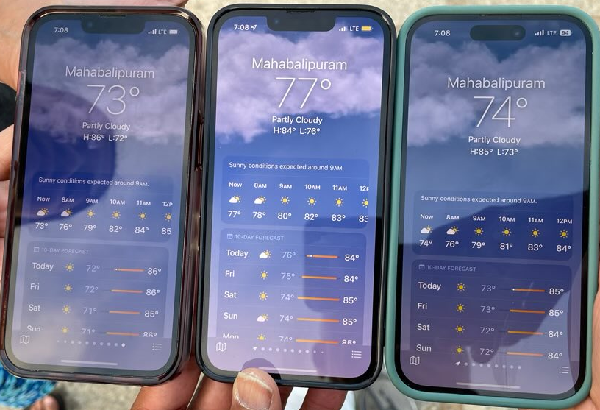

Slide 29
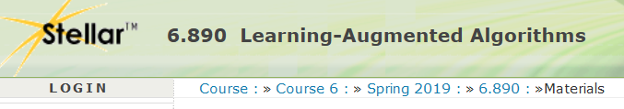
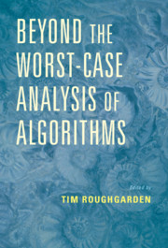
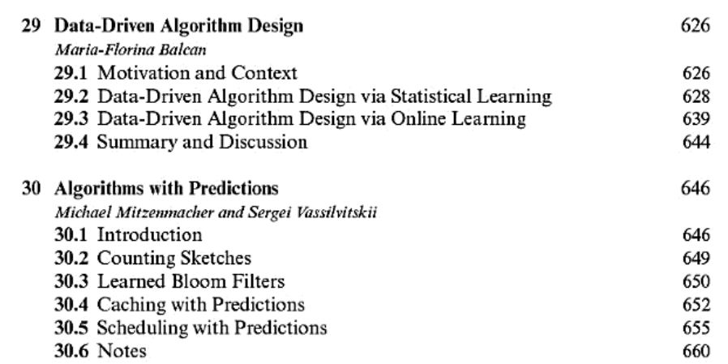

Slide 30
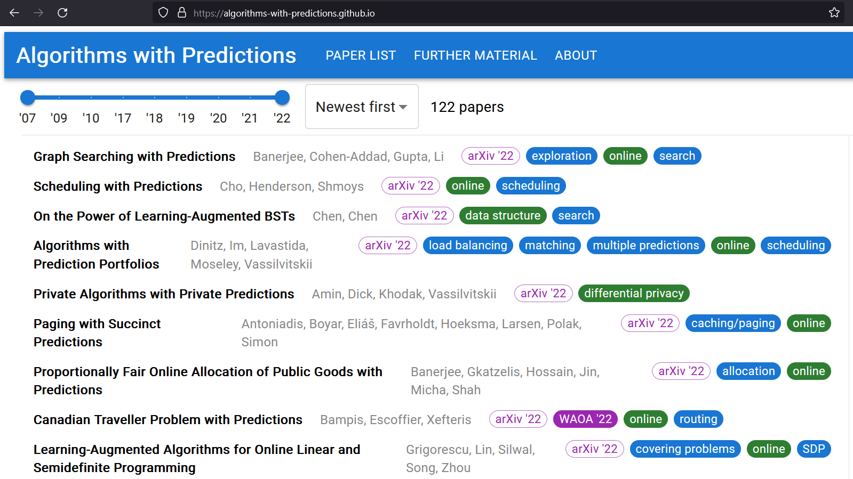

Slide 31
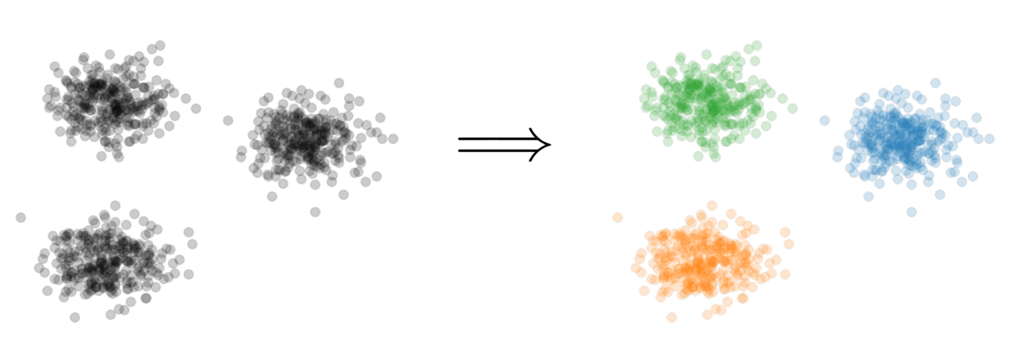

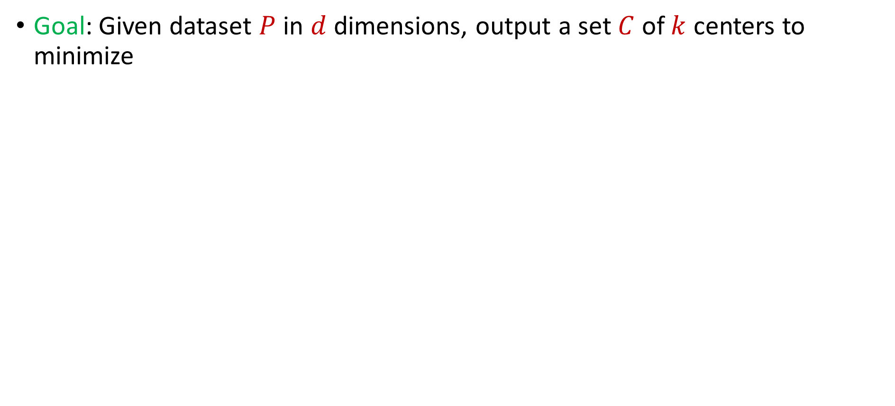
Learning-Augmented Clustering
Goal: Given dataset $P$ in $d$ dimensions, output a set $C$ of $k$ centers to minimize
$$\sum_{p∈P}{{\min_{c∈C}\left\|p−c\right\|}_{2}^{2}}$$

Slide 32
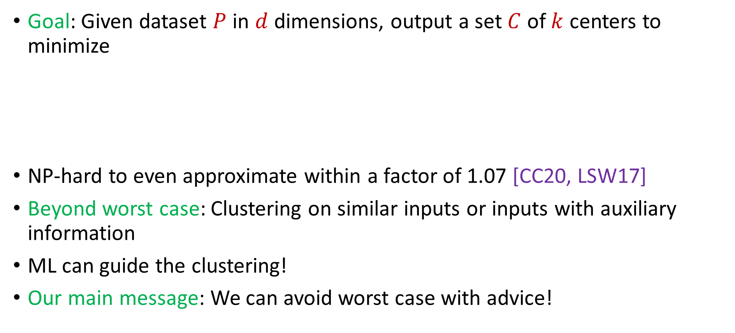
Learning-Augmented Clustering
Goal: Given dataset $P$ in $d$ dimensions, output a set $C$ of $k$ centers to minimize
NP-hard to even approximate within a factor of 1.07 [CC20, LSW17]
Beyond worst case: Clustering on similar inputs or inputs with auxiliary information
ML can guide the clustering!
Our main message: We can avoid worst case with advice!
$$\sum_{p∈P}{{\min_{c∈C}\left\|p−c\right\|}_{2}^{2}}$$
Notes:
[Cohen-AddadC.S.20], [LeeSchmidtWright17]

Slide 33


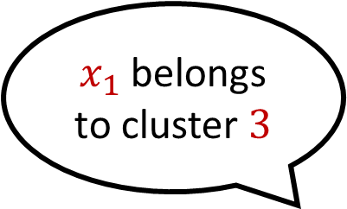
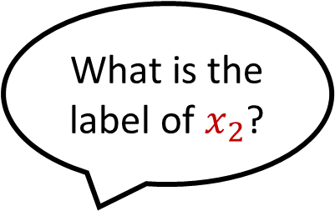

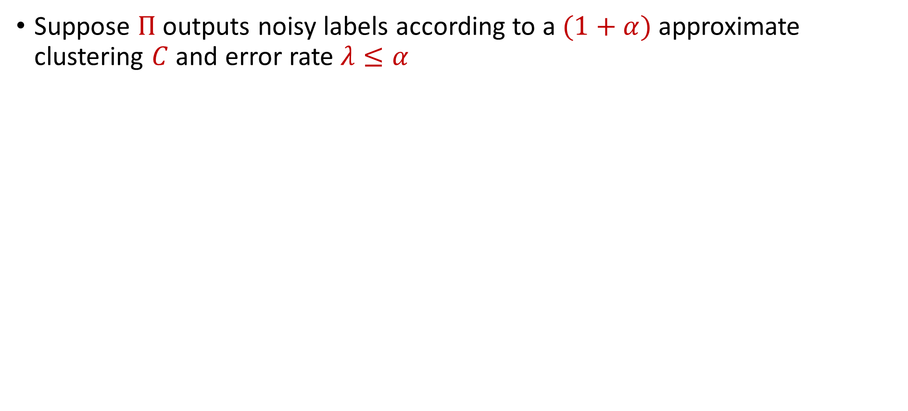
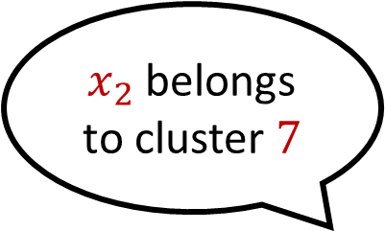
Predictor
Suppose $Π$ outputs noisy labels according to a $(1+α)$approximate clustering $C$ and error rate $λ≤α$
What is the label of $x_{1}$?
$x_{1}$ belongs to cluster $3$
What is the label of $x_{2}$?
$x_{2}$ belongs to cluster $7$

Slide 34
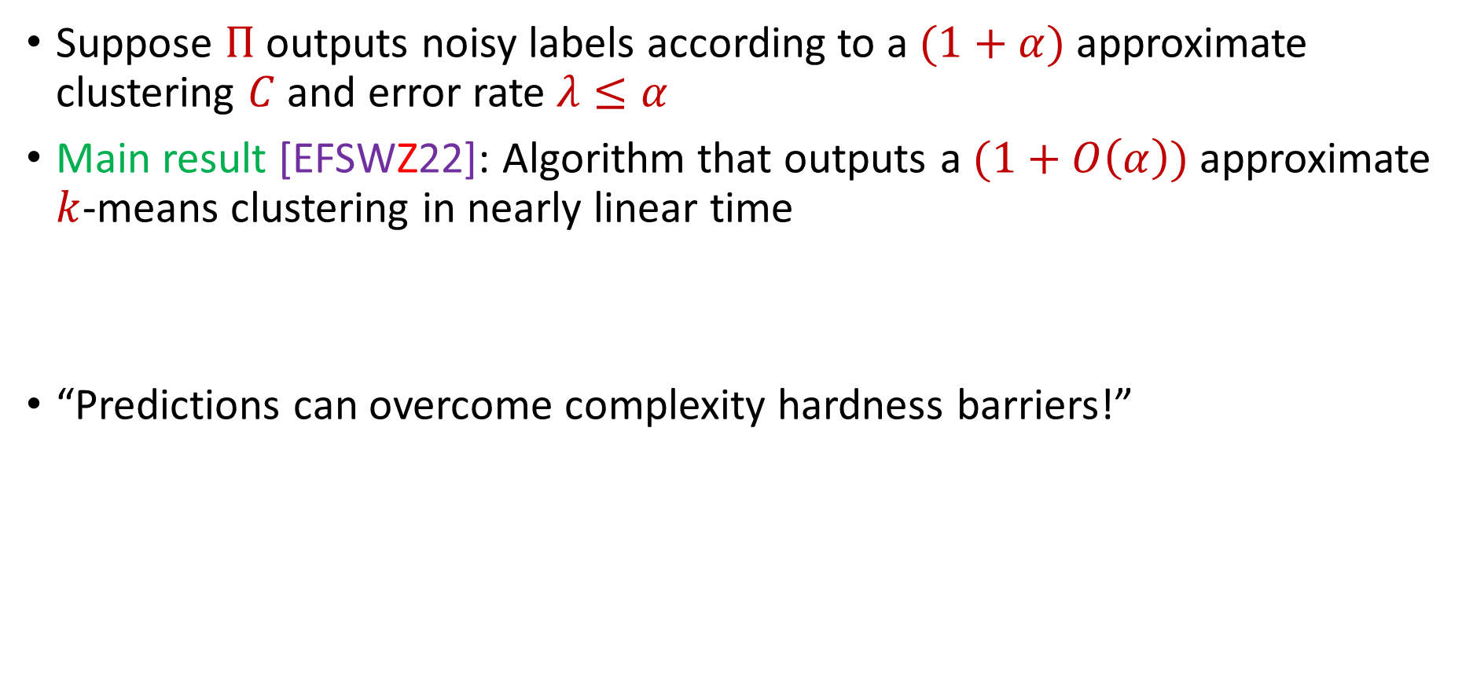
Theoretical Guarantee
Suppose $Π$ outputs noisy labels according to a $(1+α)$approximate clustering $C$ and error rate $λ≤α$
Main result [EFSWZ22]: Algorithm that outputs a $(1+O\left(α\right))$approximate $k$-means clustering in nearly linear time
“Predictions can overcome complexity hardness barriers!”

Slide 35
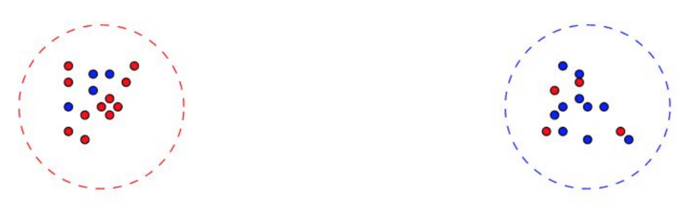
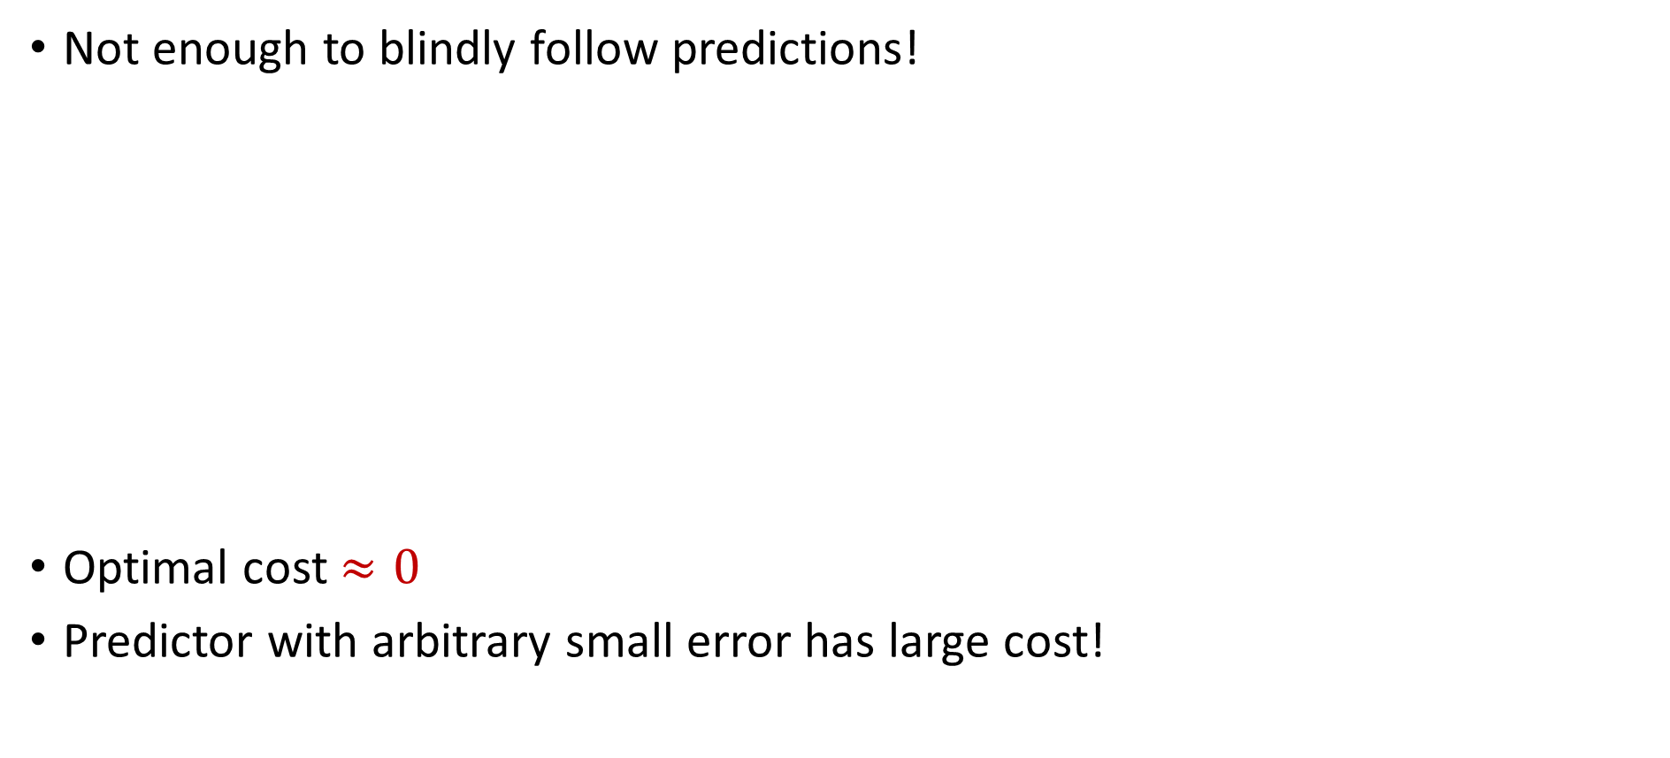
Algorithmic Intuition
Not enough to blindly follow predictions!
Optimal cost $≈0$
Predictor with arbitrary small error has large cost!
Notes:
Draw box

Slide 36
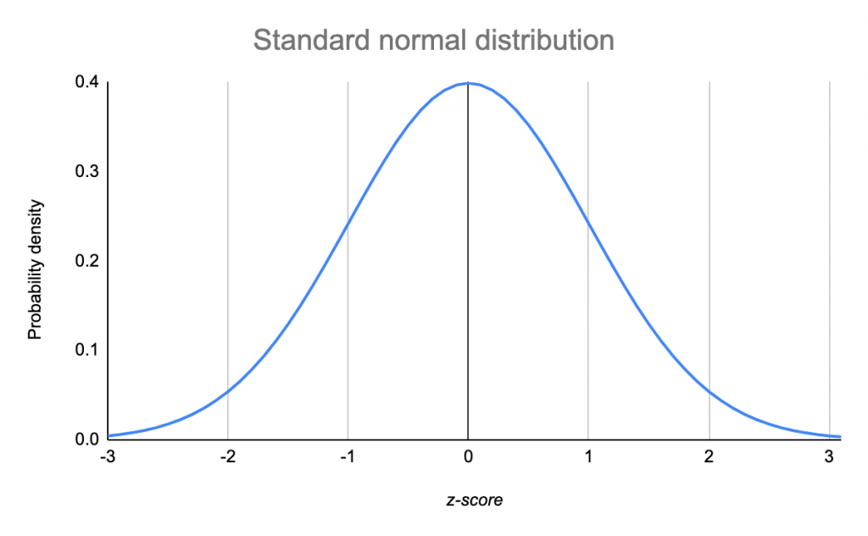
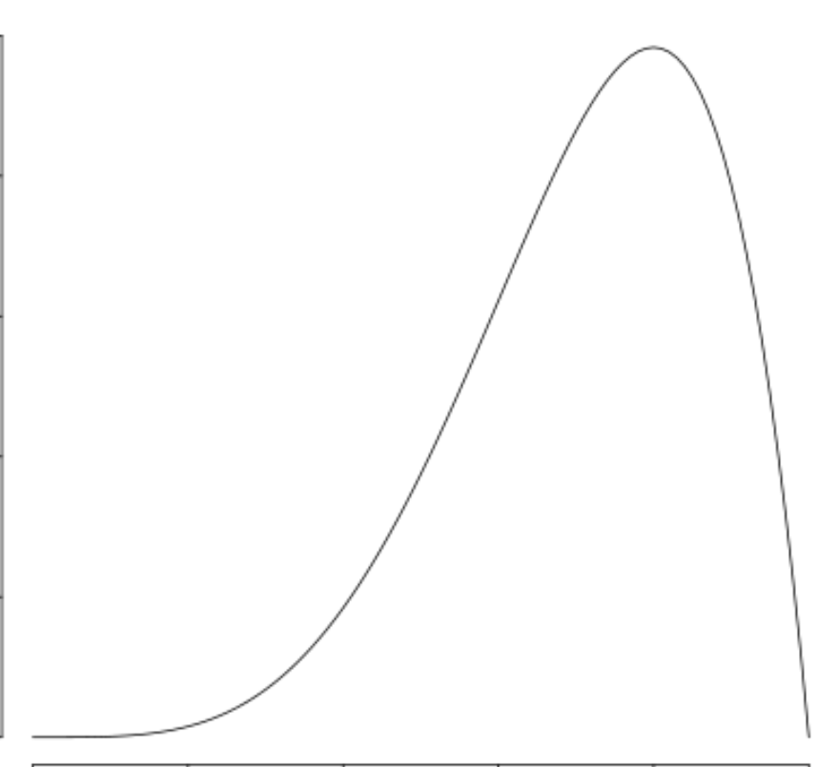
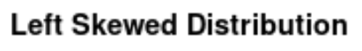


Algorithmic Intuition
Not enough to blindly follow predictions!
Our approach: Use ideas from robust mean estimation
$$\left(1−ε\right)P$$
$$εQ$$

Slide 37
Algorithmic Intuition
Not enough to blindly follow predictions!
Our approach: Use robust mean estimation
$$\left(1−ε\right)P$$
$$εQ$$

Slide 38
Algorithmic Intuition
Not enough to blindly follow predictions!
Our approach: Use robust mean estimation
$$\left(1−ε\right)P$$
$$εQ$$
Notes:
No need for interval

Slide 39
Algorithmic Intuition
Not enough to blindly follow predictions!
Our approach: Use robust mean estimation
We exploit the fact that cluster centers are means of points!

Slide 40
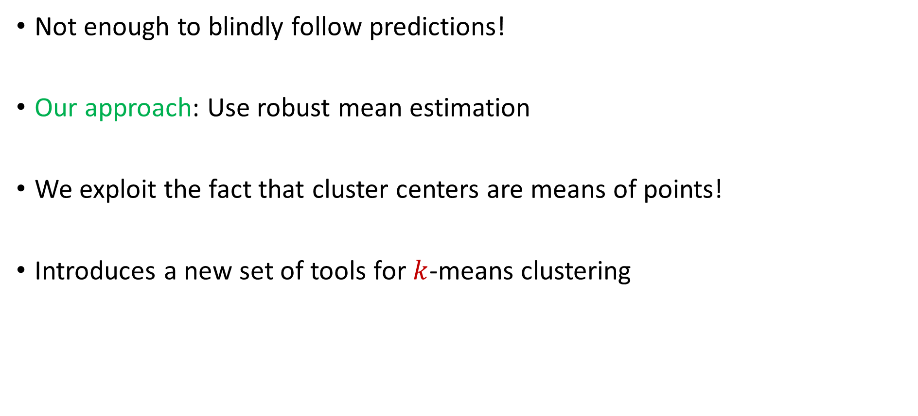
Algorithmic Intuition
Not enough to blindly follow predictions!
Our approach: Use robust mean estimation
We exploit the fact that cluster centers are means of points!
Introduces a new set of tools for $k$-means clustering

Slide 41
Experimental Results
Case Study: Spectral clustering on graphs varying over time
Dataset: Internet router graph varying over the course of a year
Methodology: Compare to standard benchmarks while using various natural predictors, i.e., noisily perturb true labels and compare to baselines as function of error
Notes:
Experiments unclear (spectral clustering)

Slide 42
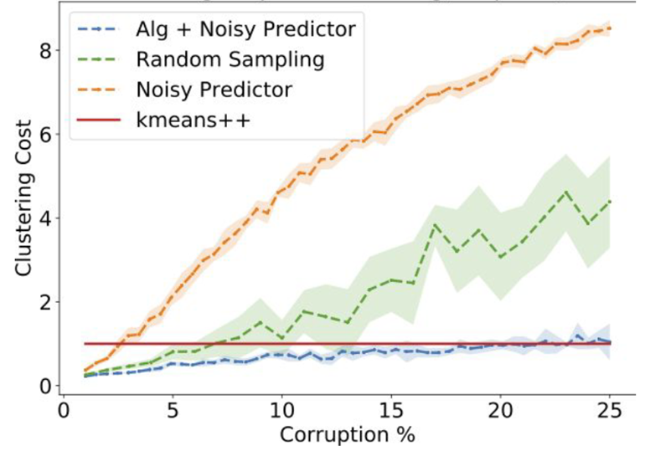
Dataset: Internet router graph varying over the course of a year, $k=10$
Conclusion: Our algorithm (using predictor) outperforms benchmarks such as $k$-means ++ for low error while staying competitive with high corruptions
Notes:
Change title

Slide 43
My Recent Work on Data Science
Learning-Augmented k-means Clustering (ICLR 2022)
Fast Regression for Structured Inputs (ICLR 2022)
New Coresets for Projective Clustering and Applications (AISTATS 2022)
Dimensionality Reduction for Wasserstein Barycenter (NeurIPS 2021)
Learning a Latent Simplex in Input Sparsity Time (ICLR 2021)
Near Optimal Linear Algebra in the Online and Sliding Window Models (FOCS 2020)
Data-Independent Neural Pruning via Coresets (ICLR 2020)
Adversarially Robust Submodular Maximization under Knapsack Constraints (KDD 2019)

Slide 44
Questions?

Slide 45
Security and Privacy for Big Data

Slide 46
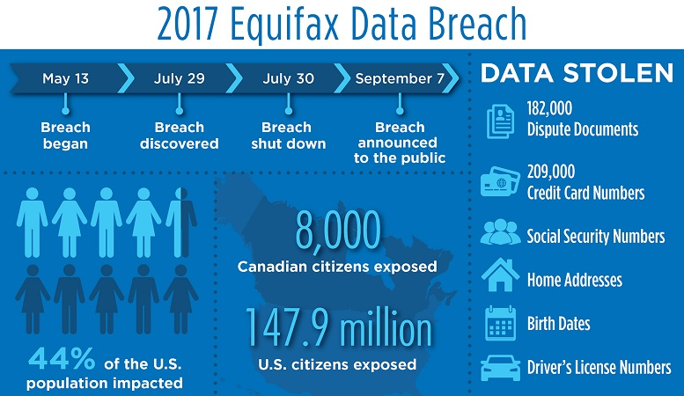
“Equifax agreed to a $700 million settlement over the privacy breach, but $425 million of that was set aside to repay consumers as a restitution fund.”
Notes:
Credit bureau company, delete $125?
Equifax Inc. is an American multinational consumer credit reporting agency headquartered in Atlanta, Georgia and is one of the three largest consumer credit reporting agencies, along with Experian and TransUnion (together known as the "Big Three"). With over 14,000 employees worldwide, Equifax has nearly US$5 billion in annual revenue and is traded on the New York Stock Exchange (NYSE) under the symbol EFX

Slide 47












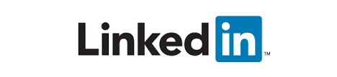


Slide 48
Evolving Demands
Sublinear-time or sublinear-space algorithms
Incorporation of advice
Security and privacy
Robustness to noise or adversarial input
Ability to handle time-sensitive data

Slide 49
Graph Theory for Memory Hard Functions
pwd
$$h_{1}$$
$$h_{2}$$
$$h_{3}$$
$$h_{5}$$
$$h_{4}$$

Slide 50
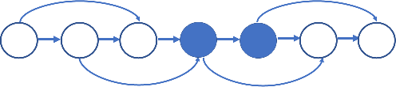
Graph Theory for Memory Hard Functions
Proved the security benefits of memory-hard functions using an economic marginal cost-revenue analysis [BHZ18]
Showed the hardness of computing [BZ18] and approximating the computational cost [BLZ20] of graph pebbling
Applied graph theory to cryptanalyze the computational complexity of memory-hard functions [BZ18, BRZ18]

Slide 51


census.gov:

Slide 52
Anonymizing Data
Age | Zip Code | Employer | Has Pet
56 | 77005 | Apple | Yes
32 | 77005 | Microsoft | No
71 | 77005 | Amazon | Yes
44 | 77005 | Petsmart | Yes
25 | 77005 | Netflix | No
61 | 77005 | Google | No

Slide 53
Anonymizing Data
Age | Zip Code | Employer | Has Pet
56 | 77005 | Apple | Yes
32 | 77005 | Microsoft | No
71 | 77005 | Amazon | Yes
44 | 77005 | Petsmart | Yes
25 | 77005 | Netflix | No
61 | 77005 | Google | No
Name | Age | Gender | Employer
Alice | 56 | Female | Apple
Bob | 32 | Male | Microsoft
Carol | 71 | Female | Amazon
Dale | 44 | Male | Petsmart
Erin | 25 | Female | Netflix
Fred | 61 | Male | Google

Slide 54
Reconstruction Attack
Name | Age | Zip Code | Gender | Employer | Has Pet
Alice | 56 | 77005 | Female | Apple | Yes
Bob | 32 | 77005 | Male | Microsoft | No
Carol | 71 | 77005 | Female | Amazon | Yes
Dale | 44 | 77005 | Male | Petsmart | Yes
Erin | 25 | 77005 | Female | Netflix | No
Fred | 61 | 77005 | Male | Google | No

Slide 55
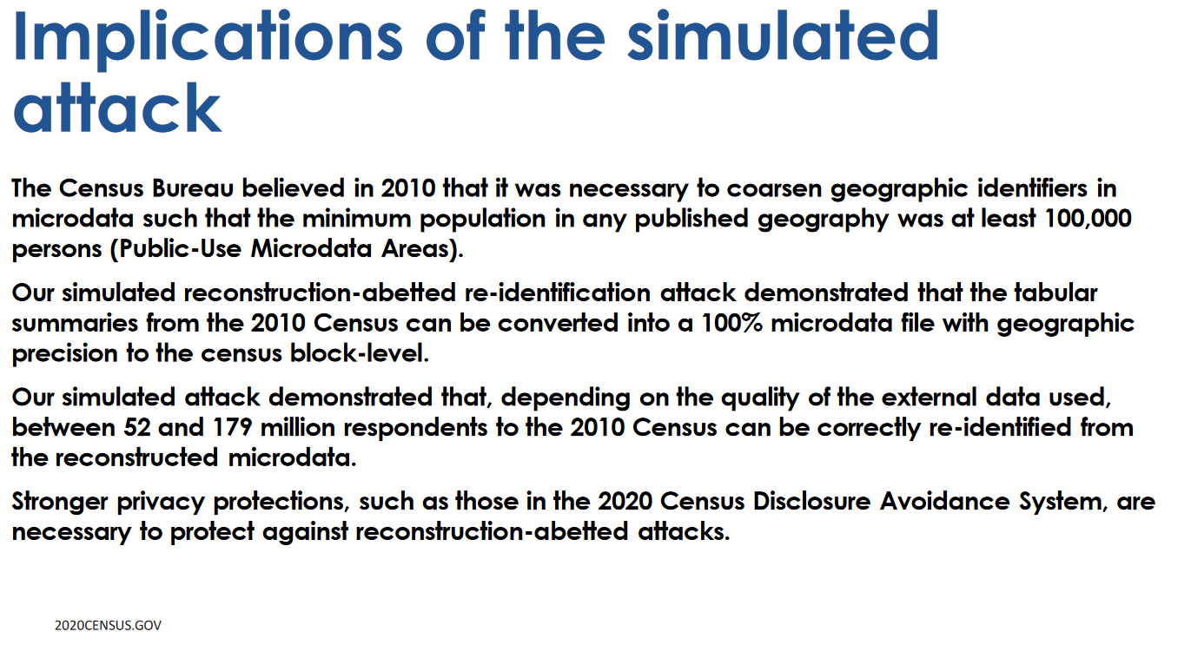

Slide 56





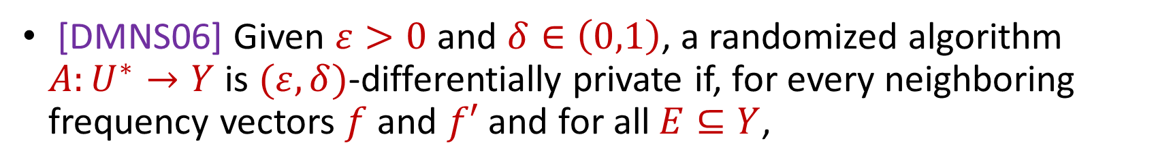
Differential Privacy
[DMNS06] Given $ε>0$and $δ∈\left(0,1\right)$, a randomized algorithm $A:U^{∗}→Y$ is $(ε,δ)$-differentially private if, for every neighboring frequency vectors $f$ and $f′$ and for all $E⊆Y$,
$$Pr\left[A\left(f\right)∈E\right]≤e^{ε}Pr\left[A\left(f^{′}\right)∈E\right]+δ$$
$$A\left( \right)≈A\left( \right)$$
Notes:
[DworkMcSherryNissimSmith06]

Slide 57
Differential Privacy Result Highlights
Framework for converting FPTAS/FPRAS algorithms to private FPTAS/FPRAS algorithms [BGMZ22]
Privacy has a price in memory cost [DSWZ23]
No overhead in communication cost for summation in the differentially oblivious shuffle model [GKNMZ22]
Notes:
Too fast

Slide 58
My Recent Work on Security and Privacy
Private Data Stream Analysis for Universal Symmetric Norm Estimation (FORC 2022)
On the Security of Proofs of Sequential Work in a Post-Quantum World (ITC 2021)
Approximating Cumulative Pebbling Cost is Unique Games Hard (ITCS 2020)
Computationally Data-Independent Memory Hard Functions (ITCS 2020)
Data-Independent Memory Hard Functions: New Attacks and Stronger Constructions (CRYPTO 2019)
Bandwidth-Hard Functions: Reductions and Lower Bounds (CCS 2018)
On the Economics of Offline Password Cracking (Security and Privacy 2018)

Slide 59
Questions?

Slide 60
Sublinear Algorithms for Processing Big Data

Slide 61
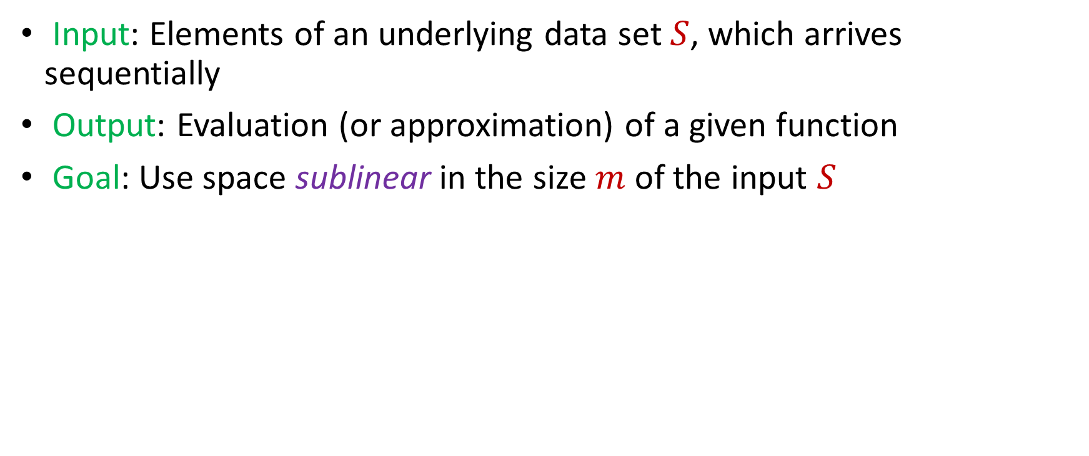
Model #1: Streaming Model
Input: Elements of an underlying data set $S$, which arrives sequentially
Output: Evaluation (or approximation) of a given function
Goal: Use space sublinear in the size $m$of the input $S$
1 0 1 1 1 0 0 1

Slide 62
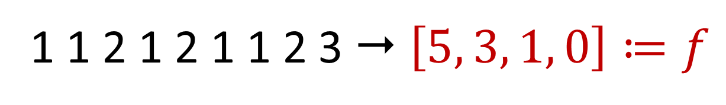
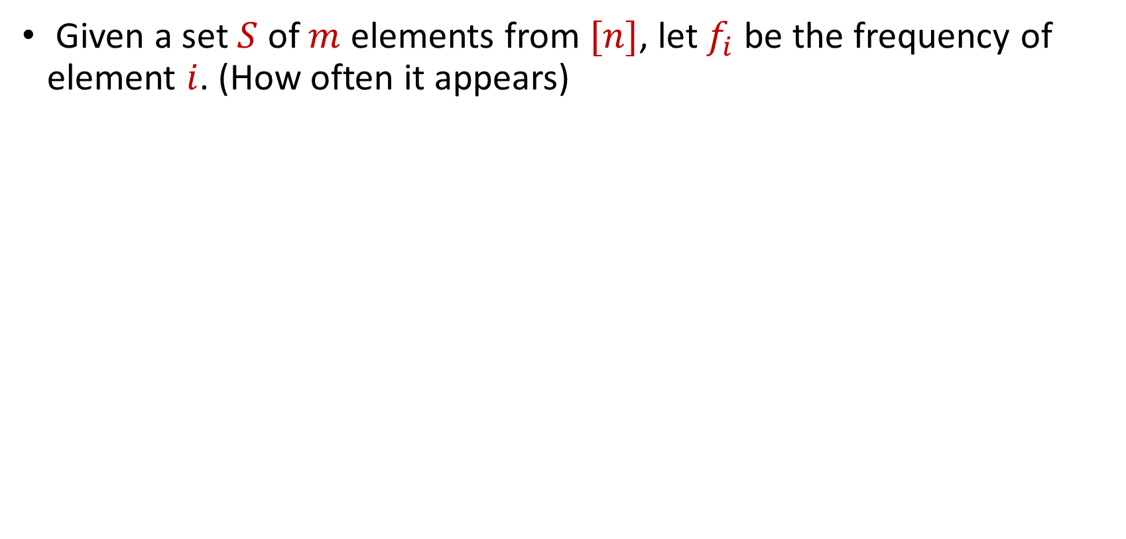
Frequency Vector
Given a set $S$ of $m$ elements from $[n]$, let $f_{i}$ be the frequency of element $i$. (How often it appears)
1 1 2 1 2 1 1 2 3  $\left[5, 3, 1, 0\right]≔f$

Slide 63


Heavy-Hitters (Frequent Items)
Given a set $S$ of $m$ elements from $[n]$, let $f_{i}$ be the frequency of element $i$. (How often it appears)
Let $L_{2}$ be the norm of the frequency vector:
Goal: Given a set $S$ of $m$ elements from $[n]$ and a threshold $ε$, output the elements $i$ such that $f_{i}>$ $ε L_{2}$...and no elements $j$ such that $f_{j}<$ $\frac{ε}{16} L_{2}$
Motivation: DDoS prevention, iceberg queries
$$L_{2}=\sqrt{f_{1}^{2}+f_{2}^{2}+…+f_{n}^{2}}$$

Slide 64



Frequency Moments ($L_{p}$ Norm)
Given a set $S$ of $m$ elements from $[n]$, let $f_{i}$ be the frequency of element $i$. (How often it appears)
Let $F_{p}$ be the frequency moment of the vector:
Goal: Given a set $S$ of $m$ elements from $[n]$ and an accuracy parameter $ε$, output a $(1+ε)$-approximation to $F_{p}$
Motivation: Entropy estimation, linear regression
$F_{p}=$ $f_{1}^{p}+f_{2}^{p}+…+f_{n}^{p}$

Slide 65


Distinct Elements ($F_{0}$ Estimation)
Given a set $S$ of $m$ elements from $[n]$, let $f_{i}$ be the frequency of element $i$. (How often it appears)
Let $F_{0}$ be the frequency moment of the vector:
Goal: Given a set $S$ of $m$ elements from $[n]$ and an accuracy parameter $ε$, output a $(1+ε)$-approximation to $F_{0}$
Motivation: Traffic monitoring
$F_{0}=$ $|\{i :f_{i}≠0\}|$

Slide 66


$\left(1+ε\right)$-Approximation Streaming Algorithms
$Θ\left(\frac{1}{ε^{2}}\right)$ space-accuracy tradeoff for distinct elements, i.e., $F_{0}$ [KNW10, Blasiok20]
$Θ\left(\frac{1}{ε^{2}}\right)$ space-accuracy tradeoff for $F_{p}$ with $p∈\left(0, 2\right]$ [BDN17]
$Θ\left(\frac{1}{ε^{2}}\right)$ space-accuracy tradeoff for $F_{p}$ with $p>2$ [Ganguly11, GW18]
$Θ\left(\frac{1}{ε^{2}}\right)$ space-accuracy tradeoff for $L_{2}$-heavy hitters [BCINWW17]
Notes:
[KaneNelsonWoodruff10], [Blasiok20], [BlasiokDingNelson17], [Ganguly11, GangulyWoodruff18], [BravermanChestnutIvkinNelsonWangWoodruff17]

Slide 67
Evolving Demands
Sublinear-time or sublinear-space algorithms
Incorporation of advice
Security and privacy
Robustness to noise or adversarial input
Ability to handle time-sensitive data

Slide 68


Human readers will easily identify the image as showing two men on skis. Google’s Cloud Vision service reported being 91 percent certain it saw a dog. Other stunts have shown how to make stop signs invisible, or audio that sounds benign to humans but is transcribed by software as “OK Google browse to evil dot com.”

Slide 69



Model #2: Adversarially Robust Streaming
Input: Elements of an underlying data set $S$, which arrives sequentially and adversarially
Output: Evaluation (or approximation) of a given function
Goal: Use space sublinear in the size $m$of the input $S$
1
1
Notes:
Let’s start by breaking down each of the terms in the title. To understand the sliding window model, we first have to understand the streaming model of computation, in which elements of an underlying data set S, arrive sequentially and the goal is to evaluate or approximate some given function on this dataset, using space sublinear in S. In the sliding window model, only the W most recent updates form the underlying data set

Slide 70
Model #2: Adversarially Robust Streaming
Input: Elements of an underlying data set $S$, which arrives sequentially and adversarially
Output: Evaluation (or approximation) of a given function
Goal: Use space sublinear in the size $m$of the input $S$
10
1
Notes:
Let’s start by breaking down each of the terms in the title. To understand the sliding window model, we first have to understand the streaming model of computation, in which elements of an underlying data set S, arrive sequentially and the goal is to evaluate or approximate some given function on this dataset, using space sublinear in S. In the sliding window model, only the W most recent updates form the underlying data set

Slide 71
Model #2: Adversarially Robust Streaming
Input: Elements of an underlying data set $S$, which arrives sequentially and adversarially
Output: Evaluation (or approximation) of a given function
Goal: Use space sublinear in the size $m$of the input $S$
101
2
Notes:
Let’s start by breaking down each of the terms in the title. To understand the sliding window model, we first have to understand the streaming model of computation, in which elements of an underlying data set S, arrive sequentially and the goal is to evaluate or approximate some given function on this dataset, using space sublinear in S. In the sliding window model, only the W most recent updates form the underlying data set

Slide 72
Model #2: Adversarially Robust Streaming
Input: Elements of an underlying data set $S$, which arrives sequentially and adversarially
Output: Evaluation (or approximation) of a given function
Goal: Use space sublinear in the size $m$of the input $S$
1010
3
Notes:
Let’s start by breaking down each of the terms in the title. To understand the sliding window model, we first have to understand the streaming model of computation, in which elements of an underlying data set S, arrive sequentially and the goal is to evaluate or approximate some given function on this dataset, using space sublinear in S. In the sliding window model, only the W most recent updates form the underlying data set

Slide 73

Model #2: Adversarially Robust Streaming
Input: Elements of an underlying data set $S$, which arrives sequentially and adversarially
Output: Evaluation (or approximation) of a given function
Goal: Use space sublinear in the size $m$of the input $S$
1010
3
Notes:
Let’s start by breaking down each of the terms in the title. To understand the sliding window model, we first have to understand the streaming model of computation, in which elements of an underlying data set S, arrive sequentially and the goal is to evaluate or approximate some given function on this dataset, using space sublinear in S. In the sliding window model, only the W most recent updates form the underlying data set

Slide 74


$\left(1+ε\right)$-Robust Algorithms [WZ21]
$\tilde{Θ}\left(\frac{1}{ε^{2}}\right)$ space-accuracy tradeoff for distinct elements, i.e., $F_{0}$
$\tilde{Θ}\left(\frac{1}{ε^{2}}\right)$ space-accuracy tradeoff for $F_{p}$ with $p∈\left(0, 2\right]$
$\tilde{Θ}\left(\frac{1}{ε^{2}}\right)$ space-accuracy tradeoff for $F_{p}$ with integer $p>2$
$\tilde{Θ}\left(\frac{1}{ε^{2}}\right)$ space-accuracy tradeoff for $L_{2}$-heavy hitters
“No losses* are necessary!”
Notes:
[KaneNelsonWoodruff10], [Blasiok20], [BlasiokDingNelson17], [Ganguly11, GangulyWoodruff18], [BravermanChestnutIvkinNelsonWangWoodruff17]

Slide 75



Slide 76


Additional Work
[BHMSSZ22] showed that “sampling-based” algorithms achieve adversarial robustness “for-free”
[ABJSSWZ22] showed impossibility results for many natural problems for “white-box” adversaries
[ABJSSWZ22] gave a sublinear-space algorithm for estimating $F_{0}$ when the white-box adversary has polynomial computation time
Open Questions: 1) Is anything non-trivial possible for “black-box” adversaries that are allowed to delete elements? 2) Can lattice-based crypto be used for other algorithms robust to white-box adversaries?

Slide 77
Evolving Demands
Sublinear-time or sublinear-space algorithms
Incorporation of advice
Security and privacy
Robustness to noise or adversarial input
Ability to handle time-sensitive data
Notes:
Pictures, too many things, federated learning

Slide 78



“Facebook data policy retains user search histories for 6 months, the Apple differential privacy overview states that collected data is retained for 3 months, the Google data retention policy states that browser information may be stored for up to 9 months”
Notes:
Explicit about slide transition

Slide 79

Model #3: Sliding Window Model
Input: Elements of an underlying data set $S$, which arrives sequentially
Output: Evaluation (or approximation) of a given function
Goal: Use space sublinear in the size $m$of the input $S$
Sliding Window: “Only the $m$ most recent updates form the underlying data set $S$”
1 0 1 1 1 0 0 1
Notes:
Let’s start by breaking down each of the terms in the title. To understand the sliding window model, we first have to understand the streaming model of computation, in which elements of an underlying data set S, arrive sequentially and the goal is to evaluate or approximate some given function on this dataset, using space sublinear in S. In the sliding window model, only the W most recent updates form the underlying data set

Slide 80
Model #3: Sliding Window Model
Input: Elements of an underlying data set $S$, which arrives sequentially
Output: Evaluation (or approximation) of a given function
Goal: Use space sublinear in the size $m$of the input $S$
Sliding Window: “Only the $m$ most recent updates form the underlying data set $S$”
1 0 1 1 1 0 0 1 1

Slide 81
Model #3: Sliding Window Model
Input: Elements of an underlying data set $S$, which arrives sequentially
Output: Evaluation (or approximation) of a given function
Goal: Use space sublinear in the size $m$of the input $S$
Sliding Window: “Only the $m$ most recent updates form the underlying data set $S$”
1 0 1 1 1 0 0 1 1 0

Slide 82

Model #3: Sliding Window Model
Input: Elements of an underlying data set $S$, which arrives sequentially
Output: Evaluation (or approximation) of a given function
Goal: Use space sublinear in the size $m$of the input $S$
Sliding Window: “Only the $m$ most recent updates form the underlying data set $S$”
Emphasizes recent interactions, appropriate for time sensitive settings
1 0 1 1 1 0 0 1 1 0 1
Notes:
The sliding window model emphasizes recent data and thus is appropriate for settings that are time sensitive.

Slide 83



$\left(1+ε\right)$-Approximation Sliding Window Algorithms [WZ21]
Space $\tilde{Θ}\left(\frac{1}{ε^{2}}\right)$ algorithm for $F_{p}$ with $p∈\left(0, 2\right]$ [WZ21]
“No losses* are necessary!”

Slide 84


$\left(1+ε\right)$-Approximation Sliding Window Algorithms [BGLWZ18]
$\tilde{Θ}\left(\frac{1}{ε^{2}}\right)$ space-accuracy tradeoff for $F_{0}$, i.e., distinct elements
$\tilde{Θ}\left(\frac{1}{ε^{2}}\right)$ space-accuracy tradeoff for $L_{2}$-heavy hitters
We give nearly tight new upper and lower bounds for these problems!

Slide 85

RandNLA in the Sliding Window Model
First algorithms for problems in numerical linear algebra in the sliding window model [BDMMUWZ20]
$O\left(d^{2}\right)$space randomized sliding window algorithm for spectral sparsification (space optimal, up to lower order terms)
$O\left(dk\right)$space randomized sliding window algorithm for low-rank approximation (space optimal, up to lower order terms)
$O\left(d^{3}\right)$space randomized sliding window algorithm for $ℓ_{1}$ subspace embedding
Notes:
In this talk, we’ll focus on a space-optimal algorithm for spectral sparsification and then I’ll talk about how to modify the algorithm to get a space-optimal algorithm for low-rank approximation. Before I begin though, I’d like to advertise some other results in this work that I think are really interesting. We also get a deterministic algorithm for spectral sparsification. That’s not space optimal like the randomized algorithm but it presents a natural way of thinking about this problem that is a generalization of smooth histogram framework. We also get sliding window algorithms for L1 subspace embedding with bit complexity assumptions as well as matrix multiplication. Finally, we obtain a number of algorithms for numerical linear algebra in the online setting, which is a cool model that the next speaker will talk about.

Slide 86
My Recent Work on Sublinear Algorithms
Memory Bounds for the Experts Problem (STOC 2022)
The White-Box Adversarial Data Stream Model (PODS 2022)
Truly Perfect Samplers for Data Streams and Sliding Windows (PODS 2022)
Noisy Boolean Hidden Matching with Applications (ITCS 2022)
Adversarial Robustness of Streaming Algorithms through Importance Sampling (NeurIPS 2021)
Tight Bounds for Adversarially Robust Streams and Sliding Windows via Difference Estimators (FOCS 2021)
Separations for Estimating Large Frequency Moments on Data Streams (ICALP 2021)
Non-Adaptive Adaptive Sampling on Turnstile Streams (STOC 2020)

Slide 87

Future Research Directions
Adversarial robustness for data science/ML
Limits of learning-augmented algorithms, beyond NP-hardness, better utility bounds for DP
Data science with fairness considerations
Evolving demands of the future!
Notes:
https://marwahaha.github.io/arxiv-wordcloud/?author=Samson%20Zhou

Slide 88
Future Agenda
Department research: interdisciplinary collaborations
Department activities: social hour, reading group, lunch seminar
Regional activities: Texas Area Theory Day, Texas Area Data Science Day
Teaching: Randomized algorithms / mathematical toolkit (hashing, concentration inequalities, linear programming, convex optimization), “modern” data science (dimensionality reduction, clustering, sublinear algorithms, differential privacy)
Funding?: NSF, NIH, DARPA, Apple, Google, Meta, Microsoft
Notes:
Be optimistic about grants

Slide 89
Thank You!

Slide 90
























Thank You!

